Slide 1

Welcome to the 2nd Project Day:
(RE)DESIGN SCHOOL GROUNDS

Slide 2
PROGRAMME for the 2nd Project Day
Group formation & reflection – Day 1 of the project
Our school today
What is Biodiversity?
Current state of the school grounds
Mapping the school grounds
Our school tomorrow
Heavy rain & green roofs
Expert role-play
Planning: Our sustainable, green school grounds

Slide 3
PROGRAMME fot the 3rd Project Day
  Reflection - Day 2 of the project
  Model-making
  Feedback and discussion session
  Presentation
  Presenting our results at school

Slide 4
Introduction to the project day
WE’RE GETTING OUR SCHOOL GROUNDS READY FOR THE FUTURE
Why

Slide 5
Introduction to the project day
Review
Densification
Heat in the city
Effects of plants
Project Day 1

Slide 6
Review
DENSIFICATION
Many people live in the city
DENSIFICATION
Which things are
close together?
Infrastructure: Transport networks,
energy supply and water/wastewater systems
Many buildings are built close together

Slide 7
Review
DENSIFICATION
PROS
CONS
  Good infrastructure
  Social interaction
  Vibrant neighbourhoods
  Community services
  Jobs
  Air quality
  Environmental pollution
  Noise
  High energy consumption
  Extreme weather
  Lack of green spaces

Slide 8
Review
DENSIFICATION
heat-
retaining
materials
sealed
surfaces
CONS
Heat island effect:
Why do cities get particularly hot compared to the surrounding countryside?
less planted areas
dark
surfaces

Slide 9
WE’RE GETTING OUR SCHOOL GROUNDS READY FOR THE FUTURE
Urban green spaces reduce the heat in the city
Hypothese
shadow effect
Transpiration + evaporative cooling

Slide 10
WE’RE GETTING OUR SCHOOL GROUNDS READY FOR THE FUTURE
Impacts of climate change:
Protection against extreme weather
Promoting health and wellbeing:
The school grounds are a lovely place
Loss of biodiversity:
Promoting biodiversity
Why

Slide 11
WHAT DOES BIODIVERSITY MEAN?
Pool your ideas in a group discussion.
Write your answers on the poster.

Slide 12
WHAT DOES BIODIVERSITY MEAN?
Diversity of species
Genetic diversity
Ecosystem diversity

Slide 13
WHY IS BIODIVERSITY IMPORTANT?
The basis of life for us humans
Biological resource
Cultural value

Slide 14
WHAT THREATENS OUR BIODIVERSITY?
Habitat destruction

Slide 15
Habitat destruction
Asphalt
Buildings
Agriculture
Soil sealing
Soil degradation

Slide 16
WHAT THREATENS OUR BIODIVERSITY?
Habitat destruction
Environmental pollution

Slide 17
Environmental Pollution
Exhaust gases
Chemicals
Plastics

Slide 18
WHAT THREATENS OUR BIODIVERSITY?
Habitat destruction
Environmetal pollution
Climate change

Slide 19
Climate Change
Extreme weather
Changes to habitats

Slide 20
Biodivetsity
WHAT CAN WE DO?
Allow uncontrolled plant growth
Designing gardens that are close to nature
Creating a school garden
Greening of roofs and facades
Removing surface sealing

Slide 21
INVENTORY
What does the school grounds look like at the moment?
Write your answers on the poster during the plenary session

Slide 22
Inventory
WE ARE MAPPING THE CURRENT STATE OF OUR SCHOOL GROUNDS
We are recording the CURRENT SITUATION
on a site plan
What’s there, already?
How are these areas used?

Slide 23
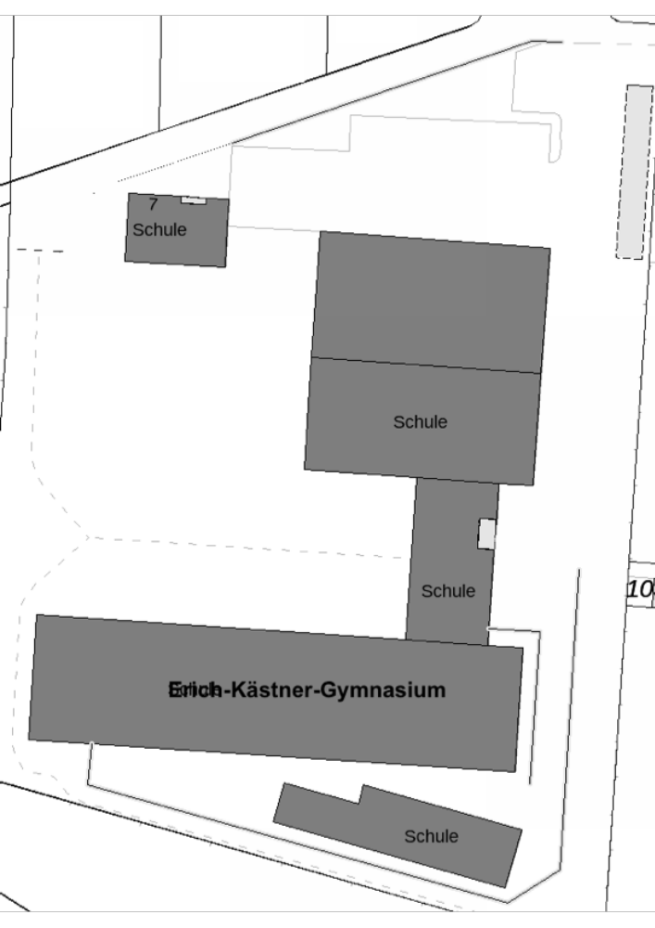
Inventory
Mapping: SCHOOL GROUNDS
Example layout of the from a school in Cologne

Slide 24
Inventory
Mapping: SCHOOL GROUNDS
Each group maps out the school grounds current situation on the site plan.
Exploration
Use the worksheets
WS 1 + WS 2
Register
Legend + Labelling
Reflection
Time: 25 min

Slide 25
Inventory
Mapping: SCHOOL GROUNDS
LET'S GO!
25 Minutes

Slide 26
WELCOME BACK!

Slide 27
THE IMPACTS OF CLIMATE CHANGE
Heat
Heavy rain

Slide 28
Heavy Rain
A lot of rain in a short period of time!
Roads flood quickly
The drainage system is overloaded
Basements are flooded

Slide 29
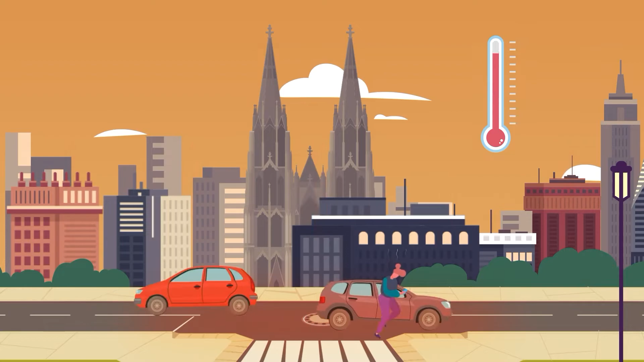
What is the current problem in the city?
Little greenery
heat
Extensive paved or sealed surfaces
Limited natural water drainage into the ground
Video Schwammstadt in 3-5 Folien umwandeln; kannst Screenshots aus dem Video nutzen; angabe aus Video StEB, muss in Impressum rein

Slide 30
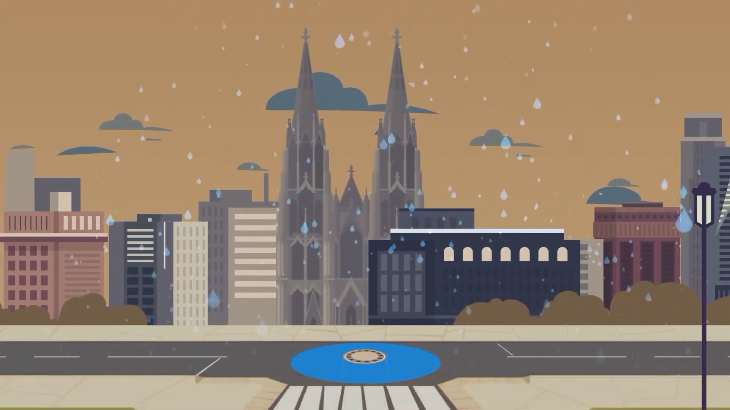
What happens during heavy rainfall?
Rain flows over sealed surfaces into the sewer system
The sewer system has only limited capacity for water
The city is flooding because the sewer system cannot handle all the rainwater

Slide 31
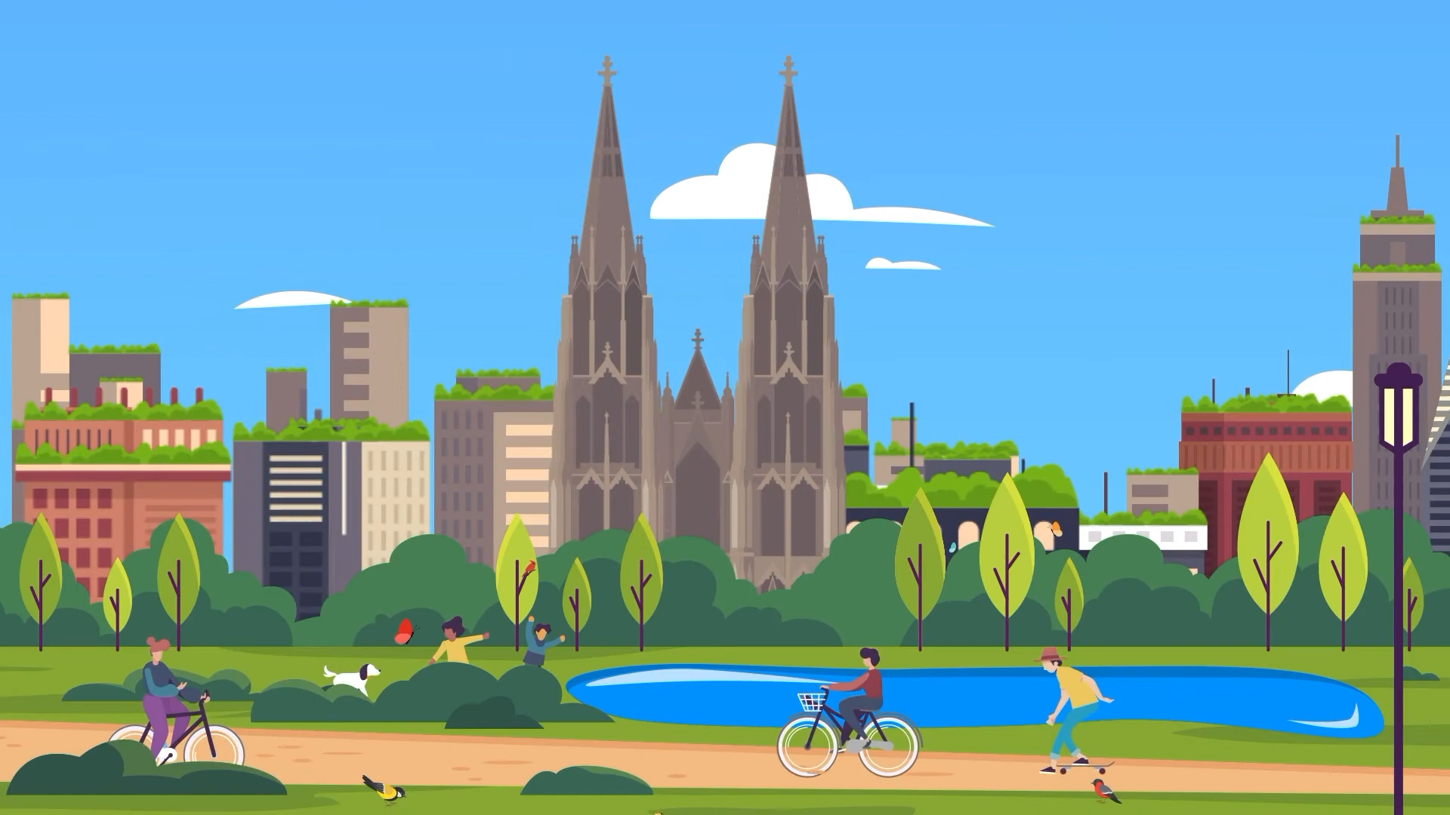
What is the solution?
The Sponge City
Flood protection through:
Unsealed surfaces
Less asphalt
More greenery in the city
Swales to improve water drainage

Slide 32
Heavy rain
Test your knowledge!
Have a go at the quiz as a group!

Slide 33

Scan me!
Quiz auf englisch

Slide 34
Heavy rain
In summary!
There are dangers caused by heavy rain!
We can protect ourselves!
Using the heavy rain hazard map!

Slide 35
From this point onwards, the slides must be adapted to the geographical features of your own country in order to map areas prone to heavy rainfall.

Slide 36

Heavy rain
Where are the areas prone to heavy rain in
our school round?
Use the heavy rain hazard map:

Slide 37
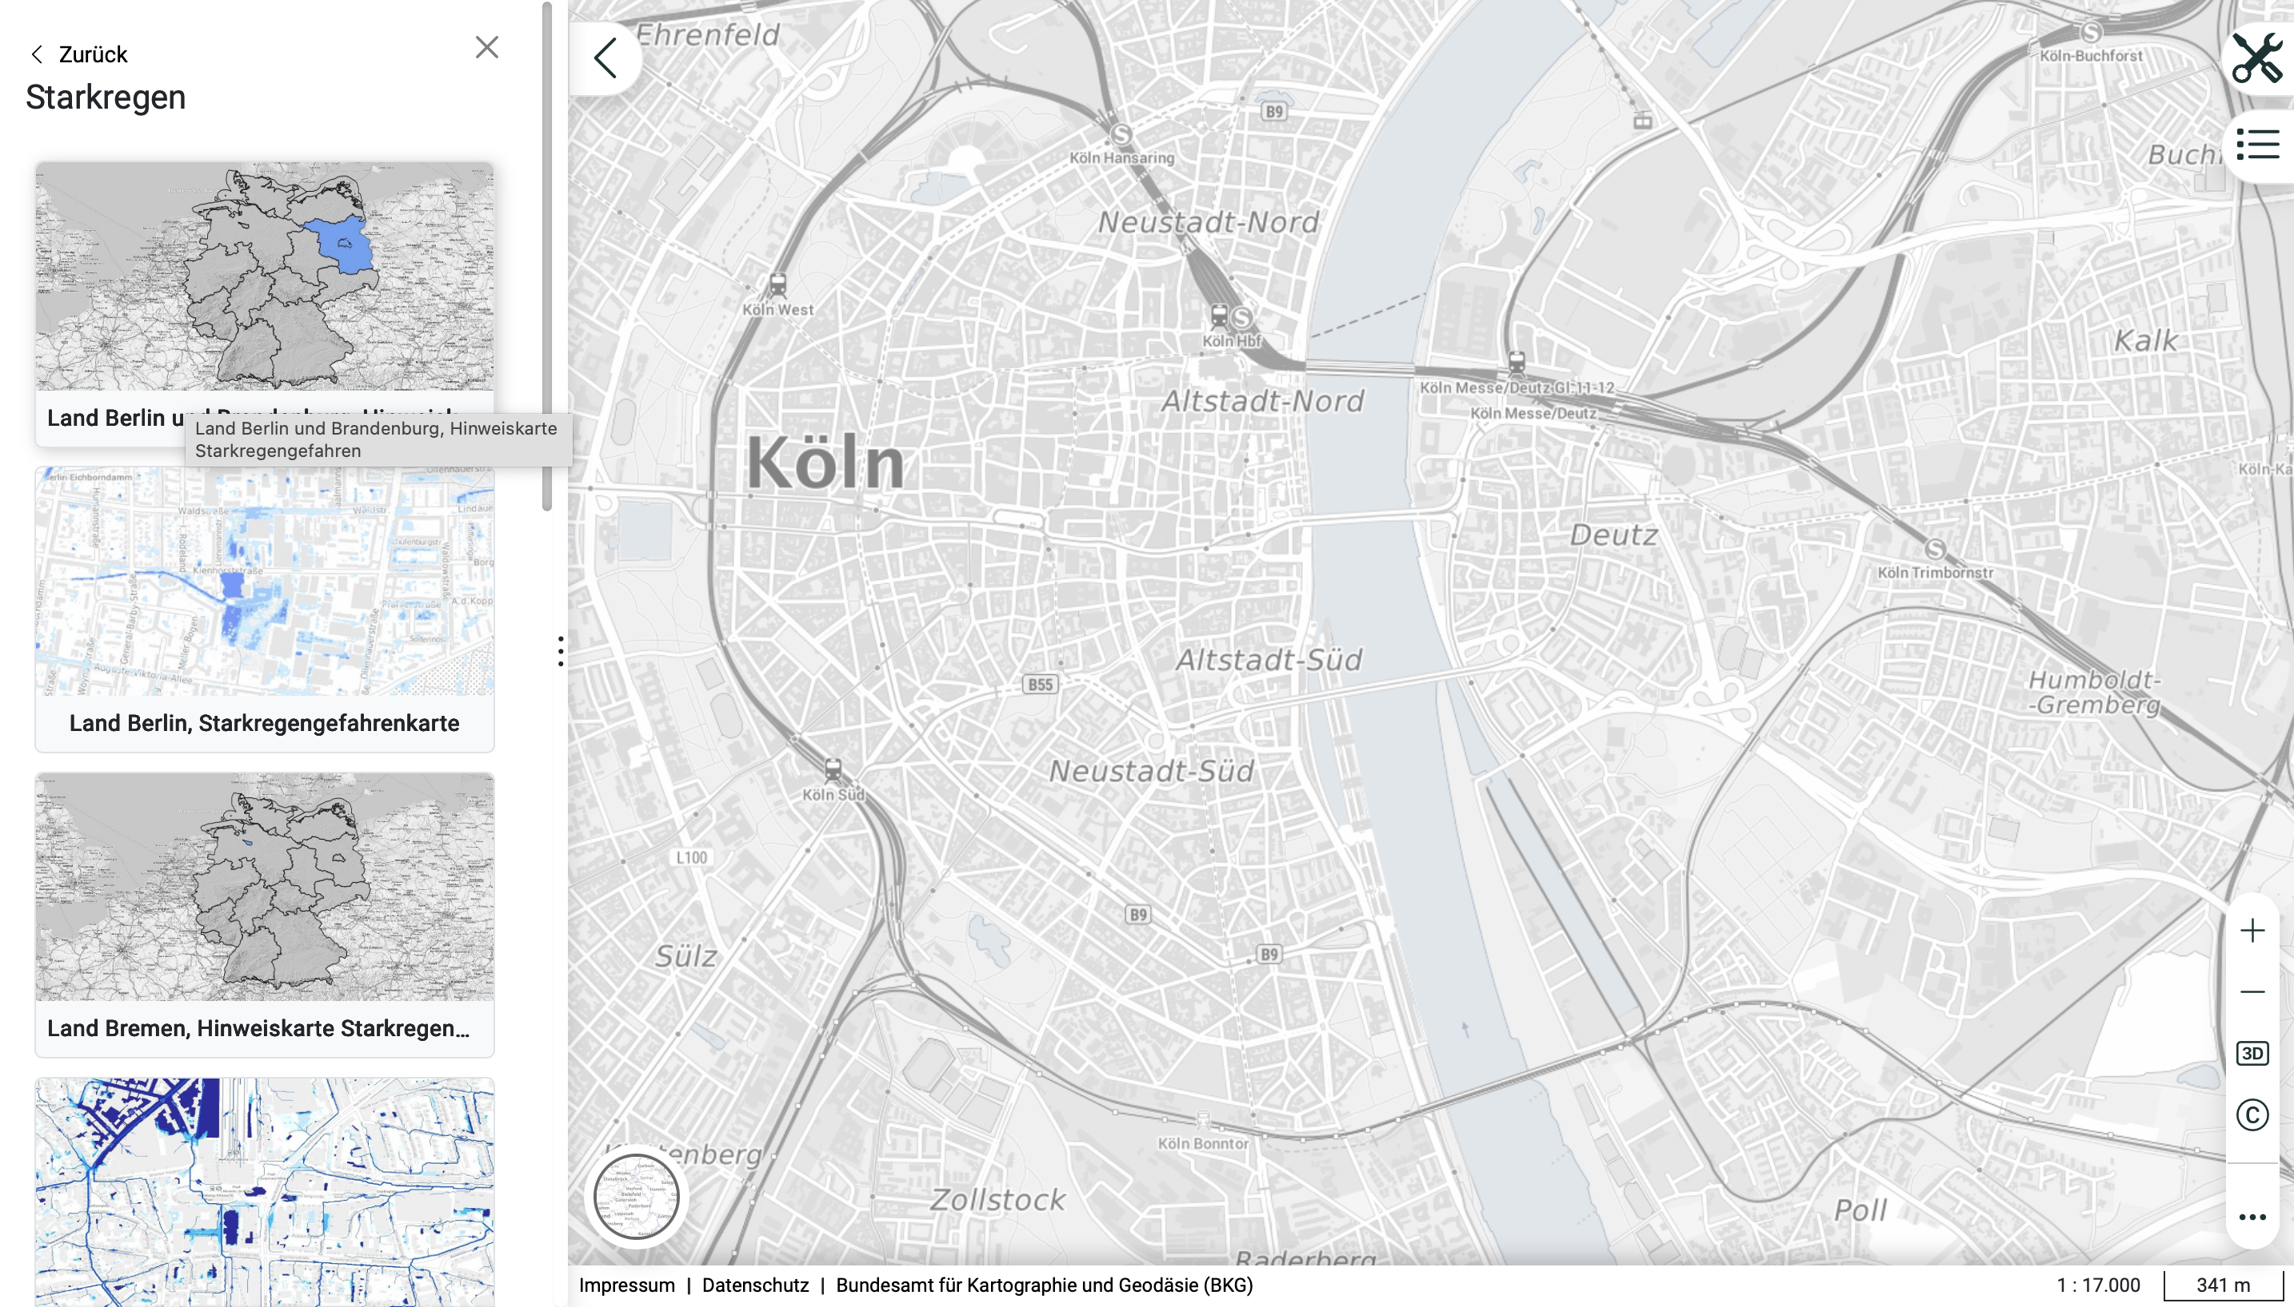

Identifying areas prone to heavy rain

Slide 38
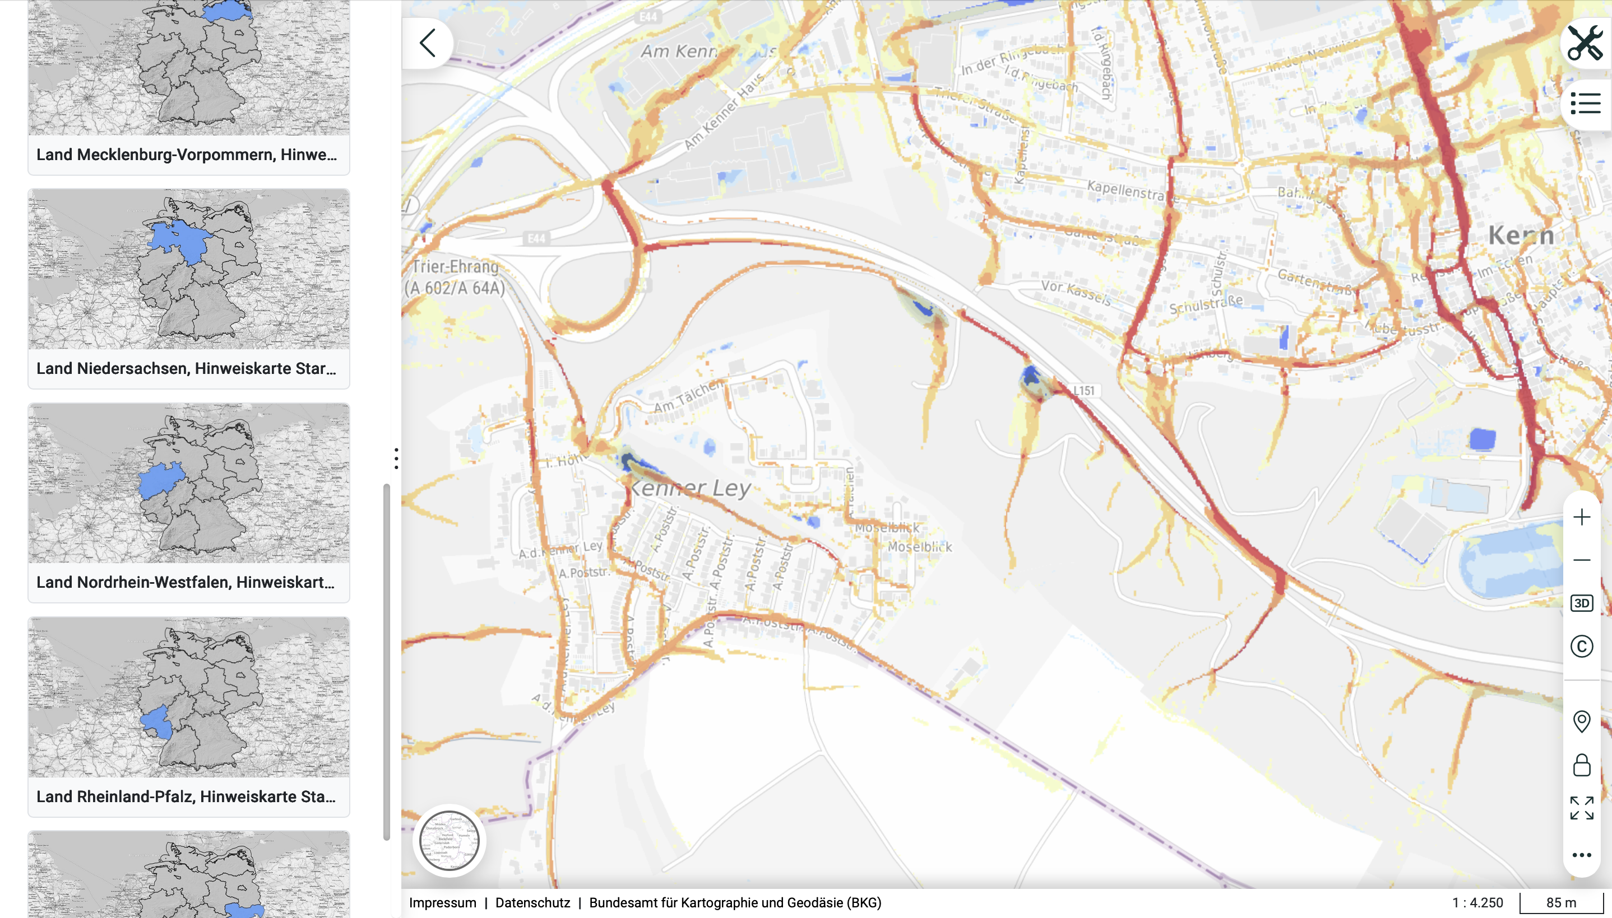
Hazard map: Heavy rain
Select your
federal state
1.

Slide 39
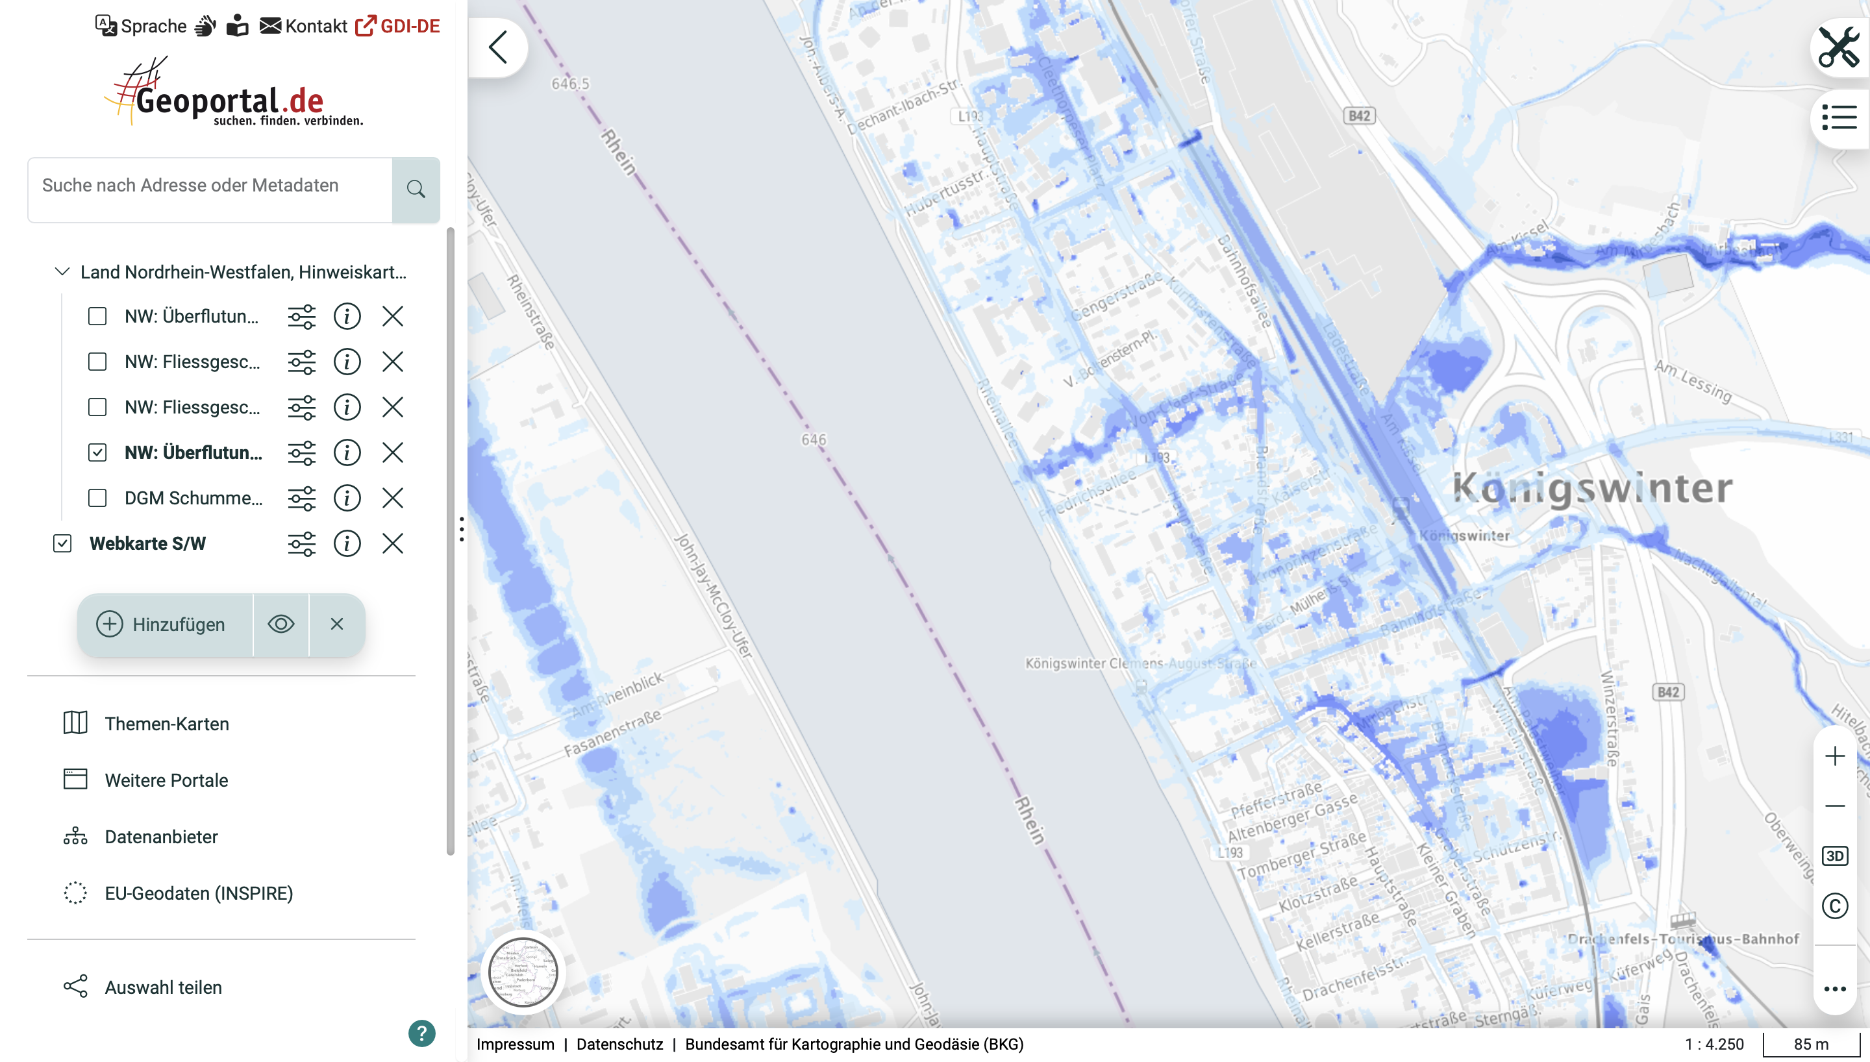
Hazard map: Heavy rain
2.
Enter your school’s address
Here, only tick the box next to ‘extreme flood level’
3.

Slide 40
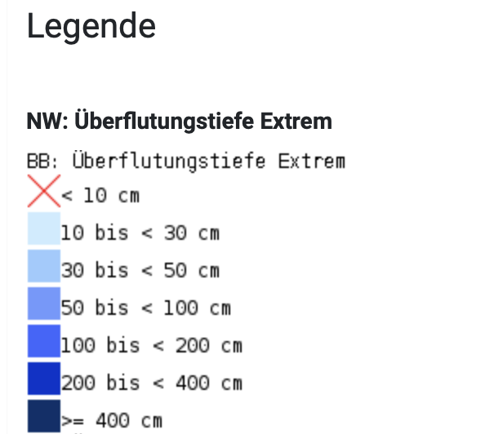
Identifying areas of heavy rain
Here, you will find
the legend

Slide 41

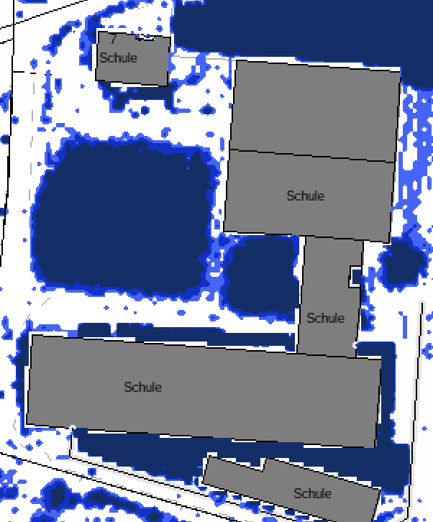
ASSIGNMENT
BLUE: Mark the areas prone to flooding
Identify potential flood-prone areas in your school grounds!
Use a BLUE coloured pencil to mark the areas affected by heavy rain on the sheet!

Slide 42
WHY GREEN ROOFS?
Promoting biodiversity
Thermal insulation in summer + protection against the cold in winter
Water storage during heavy rainfall

Slide 43
Where does the water run off to on roofs without greening?

Slide 44
HOW DOES A GREEN ROOF WORK?
Rain is falling
Insert a schematic drawing of a green roof
Water is stored
+ plants use it
Drainage system is relieved
A green roof functions like a sponge on the roof.

Slide 45
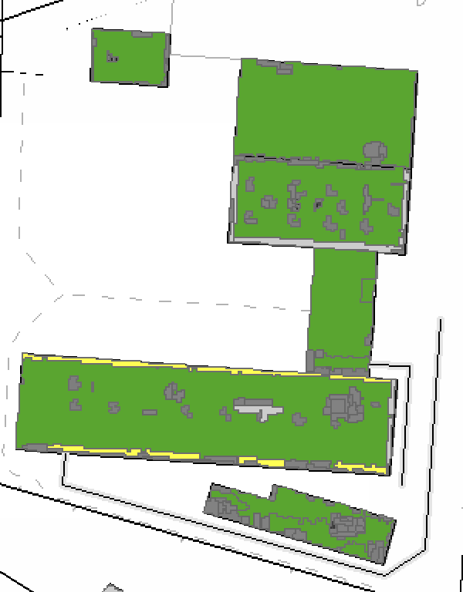
ASSIGNMENT
Use Worksheet 3: Mapping
Identify the roofs of the school building that could be greened.
To do this, use the satellite view on Google Maps and check weather your school has flat roofs. Flat roofs can be greened!
GREEN: Mark potential green roofs

Slide 46
GOAL:
OUR SCHOOL GROUNDS OF THE FUTURE

Slide 47
WE ARE PLANNING OUR
SCHOOL GROUNDS OF THE FUTURE
Expert role-play

Slide 48
Planning requires a range of specialist knowledge
Divide up the expert roles within your group
Filter the information of the expert role text using the table
Present your role as an expert to the group using the table

Slide 49
WE ARE PLANNING OUR
SCHOOL GROUNDS OF THE FUTURE
Planning

Slide 50
Design Process
Use Worksheet 4: (Re)Designing the School Ground
Write your ideas (design elements)
for planning on the poster
Take a look at the layout of your school: where could you put your ideas into practice?

Slide 51
WE ARE PLANNING OUR
SCHOOL GROUNDS OF THE FUTURE
Model-making

Slide 52



Imprint
This material was developed as part of the Erasmus+ project Green Cool Schools GROW Europe.
https://www.greencoolschools.eu
Authors: Wibke Niels und Julia Schubert, Institut für Biologie Didaktik, Universität zu Köln
Contributors: Elena Schippel, Layout, Institut für Biologiedidaktik, Universität zu Köln
Photo credits: Institut für Biologiedidaktik, Universität zu Köln
Additional photo credits: Icons: used from Canva; Page 37: Quelle: Bundesamt für Kartographie und Geodäsie (BKG): Geoportal.de, accessed on 05.09.2026; Page 29-31 Screenshots: Quelle: Stadtentwässerungsbetriebe Köln, StEB Köln (https://www.youtube.com/watch?v=MJKhyUayY_U)
Not covered by the Creative Commons licence: Icons: used from Canva; Page 37: Quelle: Bundesamt für Kartographie und Geodäsie (BKG): Geoportal.de, accessed on 05.09.2026; Page 29-31 Screenshots: Quelle: Stadtentwässerungsbetriebe Köln, StEB Köln (https://www.youtube.com/watch?v=MJKhyUayY_U)
Unless otherwise stated, this material is licensed under Creative Commons Attribution–NonCommercial–NoDerivatives 4.0 International (CC BY-NC-ND 4.0).
This material may be reproduced and shared for non-commercial purposes, provided that it remains unchanged, the original authors and source are acknowledged, and a reference to the licence is included. The distribution of modified versions is not permitted under this licence.
Additional Permission for Educational Purposes
Teachers, schools and other educational institutions are permitted to adapt this material for non-commercial teaching and educational purposes and to share adapted versions within educational contexts, provided that the original authors and the Green Cool Schools project are acknowledged and any modifications are clearly indicated.
Adapted versions must not be presented as original materials of the Green Cool Schools project.
This additional permission applies exclusively to content for which the necessary usage rights are held.
Further information about the licence: https://creativecommons.org/licenses/by-nc-nd/4.0/
Disclaimer
The content has been prepared with the greatest possible care. However, no guarantee is given as to its accuracy, completeness or currency. Liability is excluded to the extent permitted by law.
Suggested Citation
Niels, Wibke; Schubert, Julia (2025): (Re)Design Schulhof. Erasmus+ Green Cool Schools. Edited by Büro für nachhaltige Kompetenz B-NK GmbH; Institution2. Available online at: https://www.greencoolschools.eu
Views and opinions expressed are however those of the author(s) only and do not necessarily reflect those of the European Union or OeAD-GmbH. Neither the European Union nor the granting authority can be held responsible for them.

